Slide 1
Camera and Projection
Slide courtesy: S. Lazebnik, S. Savarese, M. Brown

Slide 2
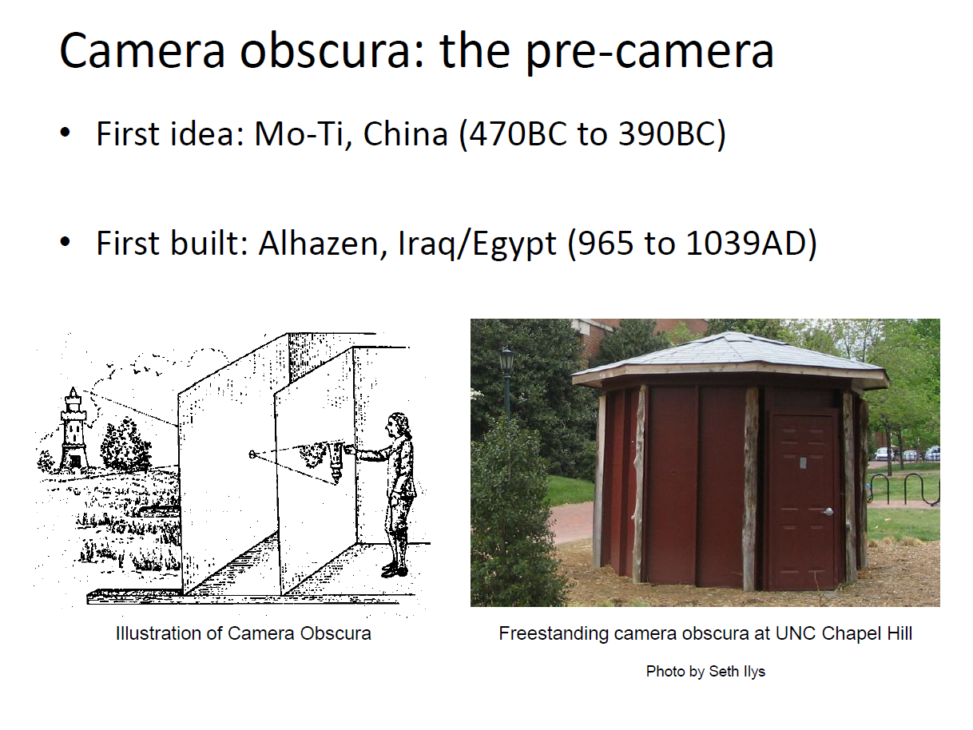

Slide 3
Camera obscura
Leonardo da Vinci (1452-1519): first record of camera obscura
"When images of illuminated objects ... penetrate through a small hole into a very dark room ... you will see [on the opposite wall] these objects in their proper form and color, reduced in size ... in a reversed position, owing to the intersection of the rays".
-- Da Vinci

Slide 4
Birth of photography
Joseph Nicephore Niepce (1822): first photo - birth of photography
Photography (Niepce, “La Table Servie,” 1822)

Slide 5
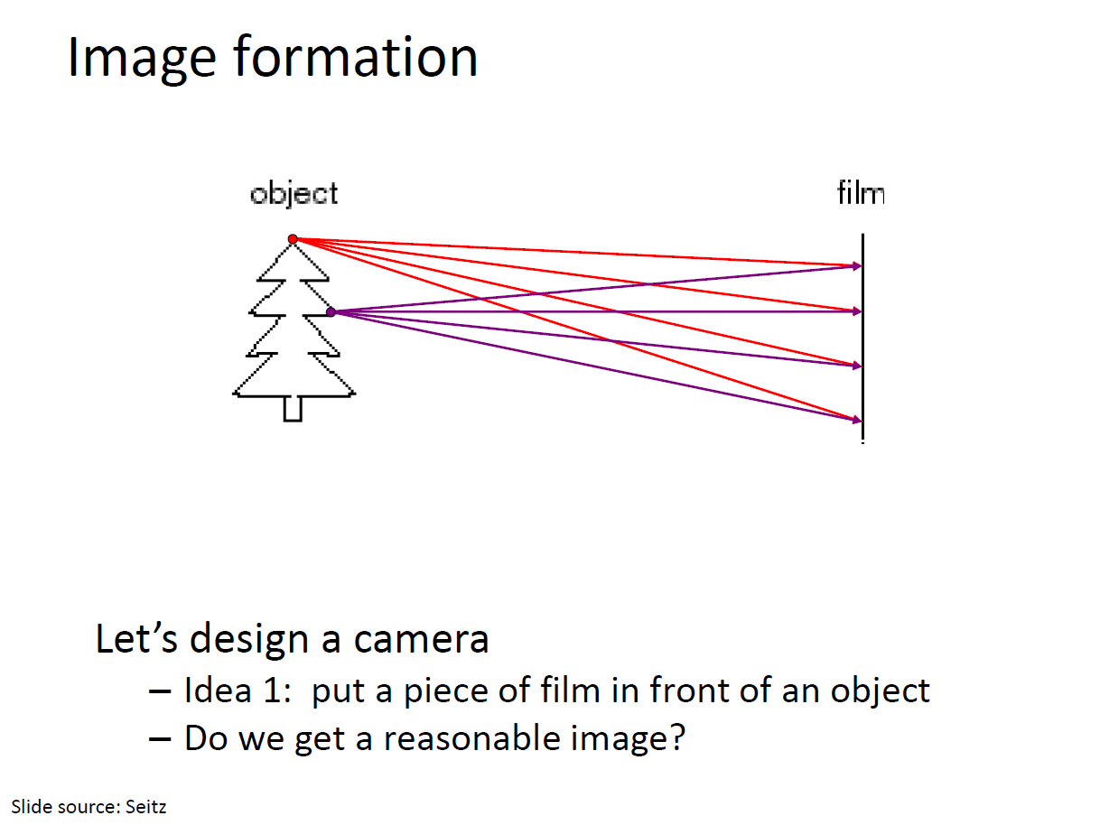

Slide 6
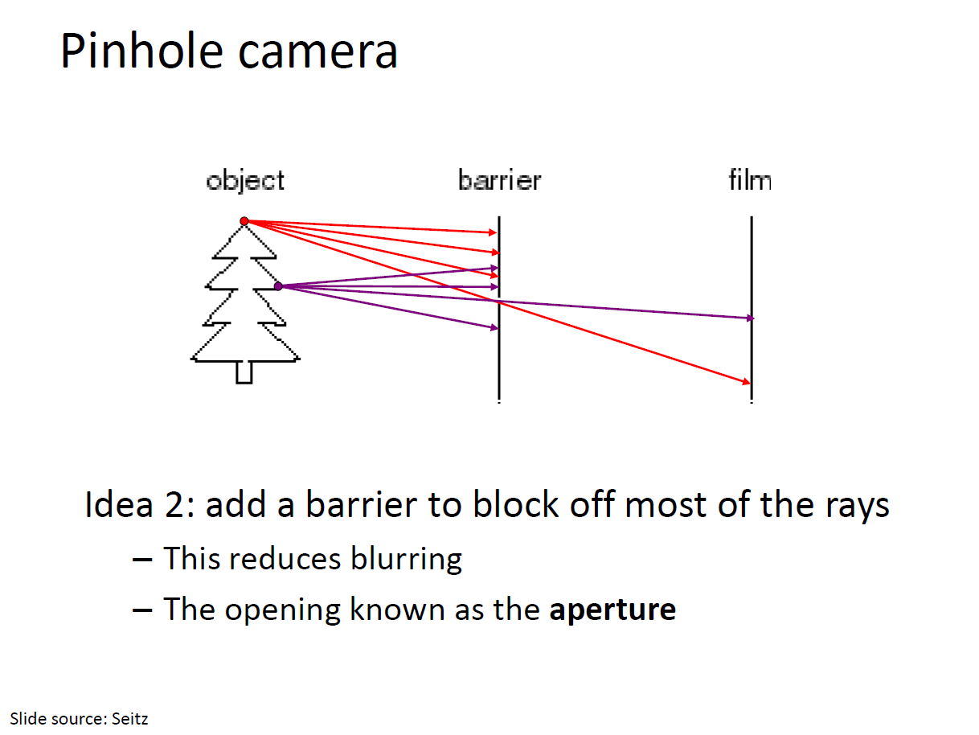

Slide 7
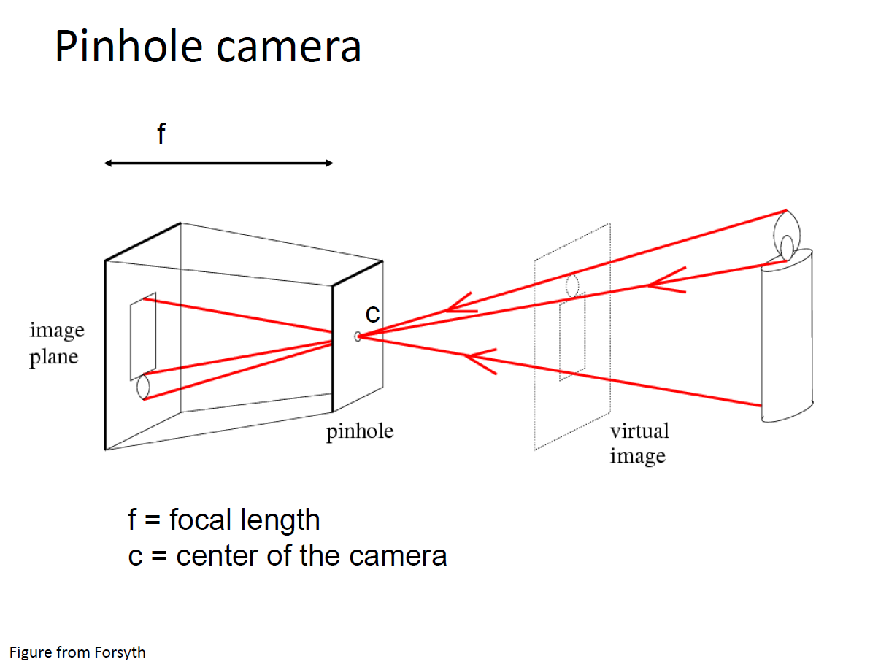

Slide 8
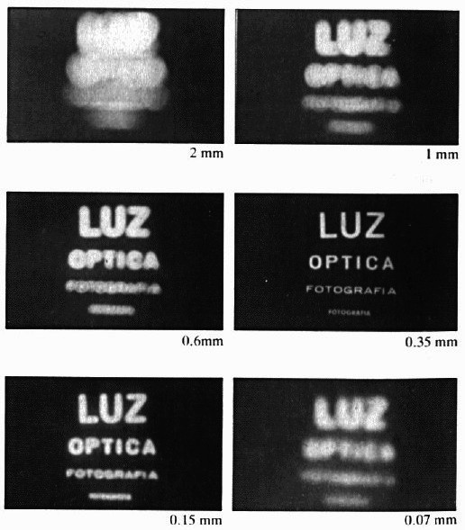
Shrinking the aperture
Why not make the aperture as small as possible?
Less light gets through
Diffraction(衍射) effects…
Slide by Steve Seitz

Slide 9
Shrinking the aperture

Slide 10
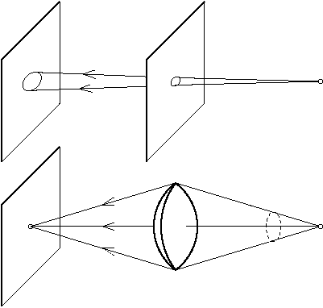
The reasons for lenses
The main reason for using a lens is to keep the picture in sharp focus while gathering light from a large area.

Slide 11
Adding a lens
A lens focuses light onto the film
Thin lens model:
Rays passing through the center are not deviated (pinhole projection model still holds)
Slide by Steve Seitz

Slide 12
Adding a lens
focal point
f
A lens focuses light onto the film
Thin lens model:
Rays passing through the center are not deviated (pinhole projection model still holds)
All parallel rays converge to one point on a plane located at the focal length f
Slide by Steve Seitz

Slide 13
Adding a lens
“circle of
confusion”
A lens focuses light onto the film
There is a specific distance at which objects are “in focus”
other points project to a “circle of confusion” in the image
Slide by Steve Seitz

Slide 14
Thin lens formula
What is the relation between the focal length ( f ), the distance of the object from the optical center (D), and the distance at which the object will be in focus (D′)?
D′
D
f
image plane
lens
object
Slide by Frédo Durand
Notes:
This is the relation between the focal length (f), the distance of the object from the camera (D), and the distance at which the object will be in focus (D’)

Slide 15
Thin lens formula
Similar triangles everywhere!
D′
D
f
image plane
lens
object
Slide by Frédo Durand

Slide 16
Thin lens formula
y′/y = D′/D
Similar triangles everywhere!
D′
D
f
y
y′
image plane
lens
object
Slide by Frédo Durand

Slide 17
Thin lens formula
y′/y = D′/D
Similar triangles everywhere!
y′/y = (D′−f )/f
D′
D
f
y
y′
image plane
lens
object
Slide by Frédo Durand

Slide 18
Thin lens formula
1
1
1
Any point satisfying the thin lens equation is in focus.
+
=
D′
D
f
D′
D
f
image plane
lens
object
Slide by Frédo Durand
Notes:
And the set of all such points forms a plane parallel to the image (plane of focus).
Uses of the formula: given focal length and depth in scene that you want to be in focus, it tells you where to put the image plane. Given f and distance of image plane from camera center, it tells you which depth in the scene will be in focus.

Slide 19

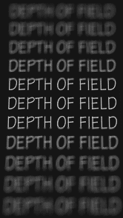
Depth of Field
http://www.cambridgeincolour.com/tutorials/depth-of-field.htm
Slide by A. Efros
Notes:
Depth of field is the distance between the nearest and farthest objects in a scene that appear acceptably sharp in an image (Wikipedia)

Slide 20
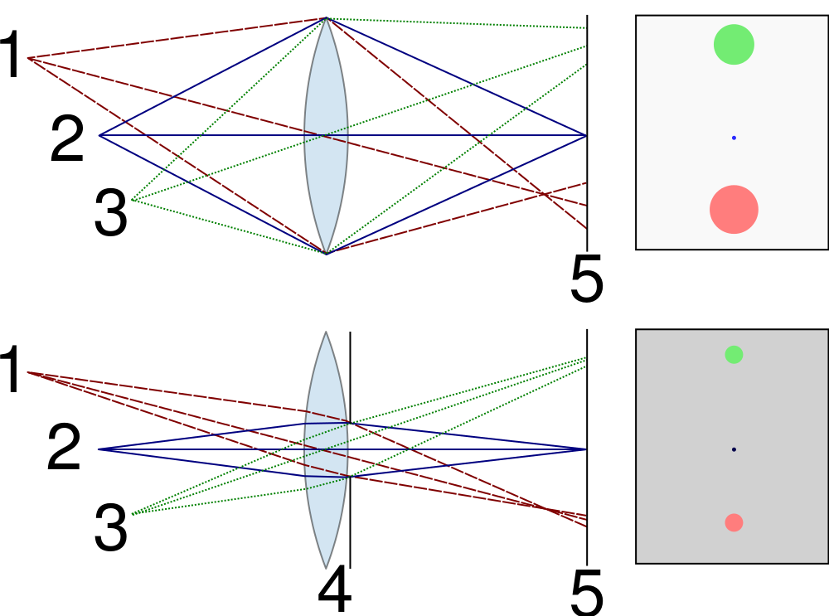


Controlling depth of field
Changing the aperture size affects depth of field
A smaller aperture increases the range in which the object is approximately in focus
But small aperture reduces amount of light – need to increase exposure
http://en.wikipedia.org/wiki/File:Depth_of_field_illustration.svg

Slide 21
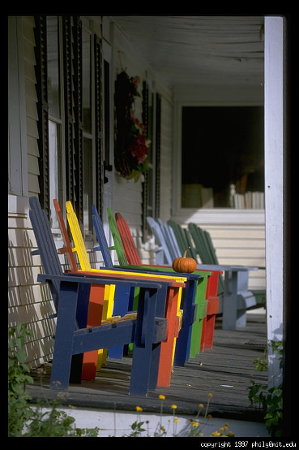
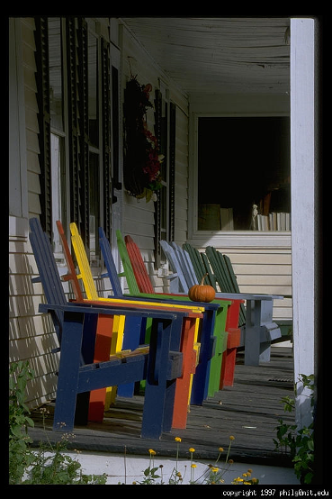
Varying the aperture
Large aperture = small DOF
Small aperture = large DOF
Slide by A. Efros

Slide 22
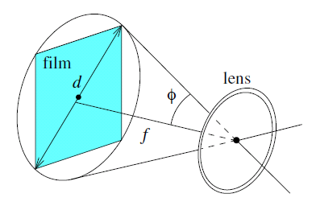
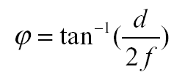
Field of view (FOV)
Field of view: portion of scene space that actually projects onto the retina of the camera
Determined by the focal length and the effective area of the retina (or CCD, film, etc)
d - the effective diameter of the sensor/lens
f - focal length
f/d - f number
FOV - 2φ
Wide-angle lens(广角镜头): when the focal length is (much) shorter than the effective diameter of the retina
Telephoto lens(长焦镜头): have a small field of view and produce pictures closer to affine ones

Slide 23
Field of View
Slide by A. Efros
Notes:
The field of view is the angular extent of the world that is observed by the camera.

Slide 24
Field of View
Slide by A. Efros

Slide 25
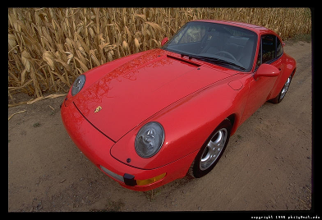
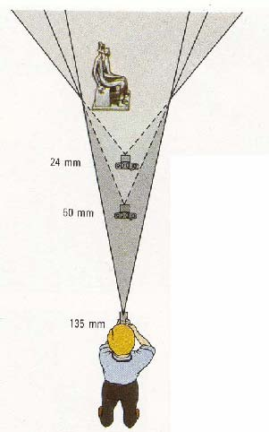
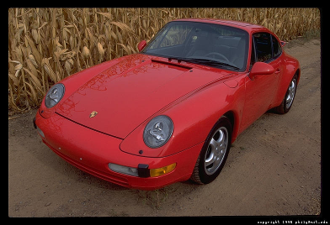
Field of View / Focal Length
Large FOV, small f
Camera close to car
Small FOV, large f
Camera far from the car
Sources: A. Efros, F. Durand

Slide 26
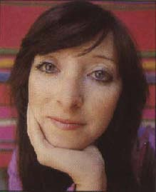


Same effect for faces
wide-angle
standard
telephoto
Source: F. Durand

Slide 27
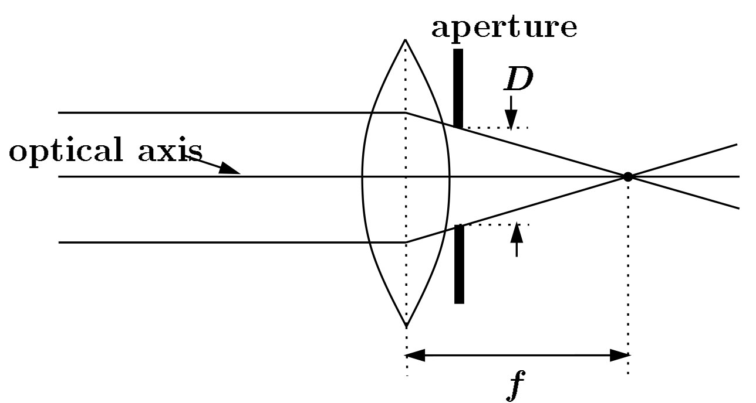
Exposure = aperture + shutter speed
F
Aperture of diameter D restricts the range of rays (aperture may be on either side of the lens)
Shutter speed is the amount of time that light is allowed to pass through the aperture

Slide 28
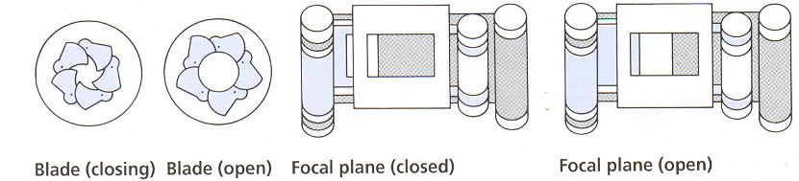
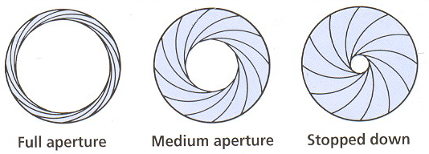
Exposure
Two main parameters:
Aperture (in f stop)
Shutter speed (in fraction of a second)

Slide 29
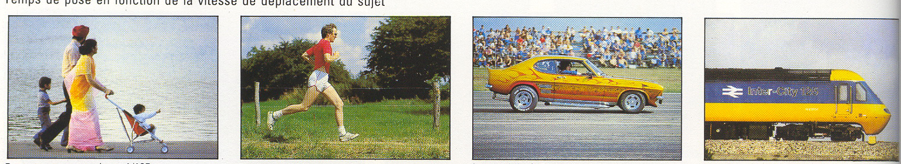
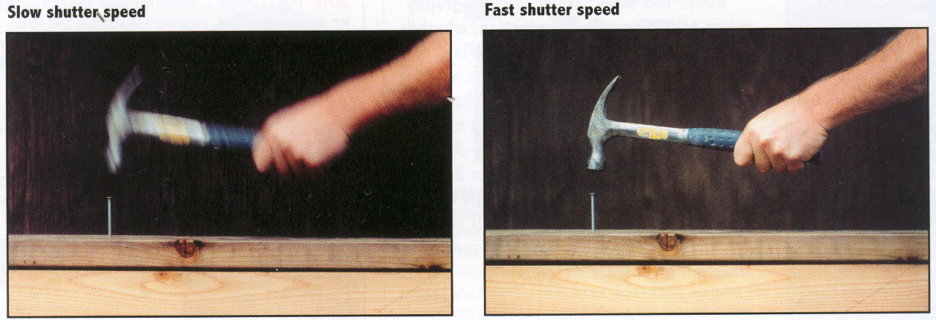
Effects of shutter speeds
Slower shutter speed => more light, but more motion blur
Faster shutter speed freezes motion
From Photography, London et al.
Walking people
Running people
Car
Fast train
1/125
1/250
1/500
1/1000

Slide 30
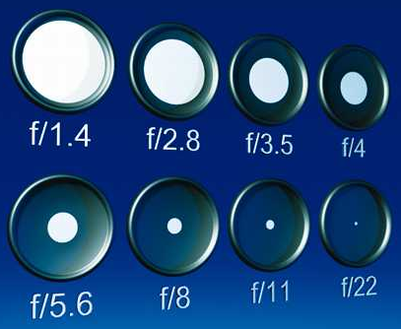
Aperture
Aperture is the diameter of the lens opening, usually specified by f-stop, f/D, a fraction of the focal length.
f/2.0 on a 50mm means that the aperture is 25mm
f/2.0 on a 100mm means that the aperture is 50mm
When a change in f-stop occurs, the light is either doubled or cut in half.
Lower f-stop, more light (larger lens opening)
Higher f-stop, less light (smaller lens opening)
Notes:
http://www.uscoles.com/fstop.htm
1.4 2.0 2.8 4 5.6 8 11 16 22

Slide 31
In-camera Imaging Pipeline

Slide 32
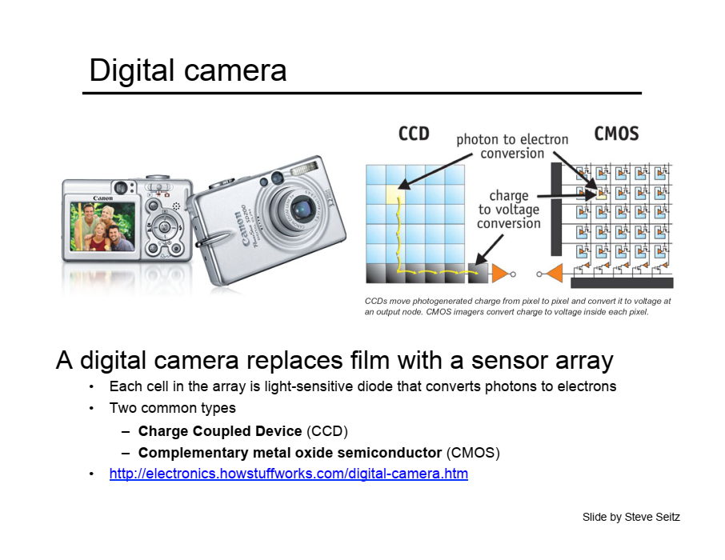

Slide 33
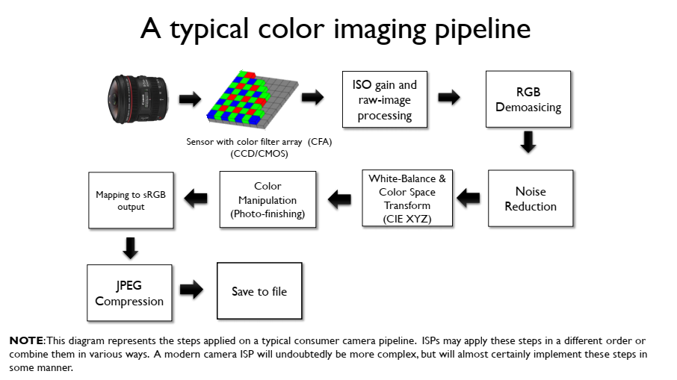

Slide 34
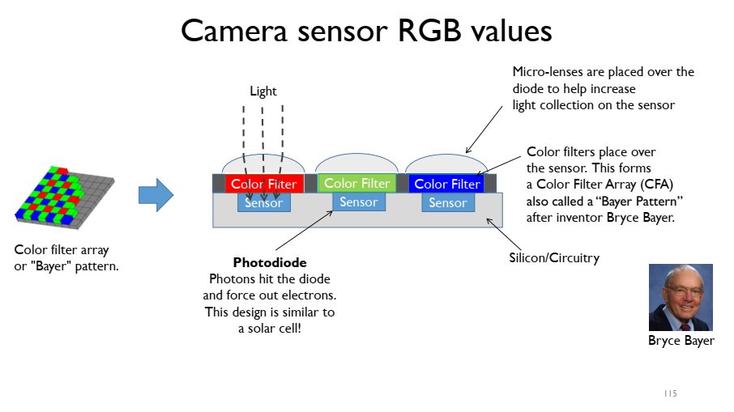
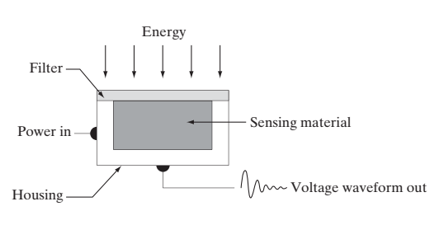

Slide 35
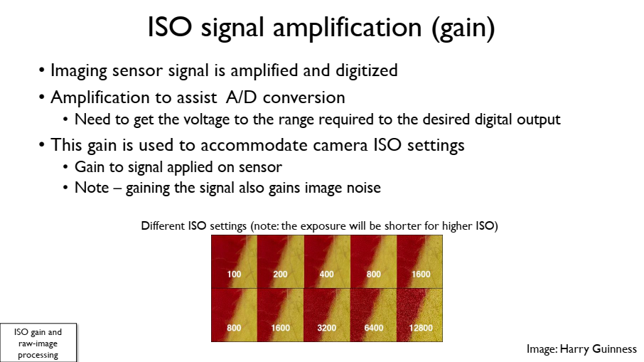

Slide 36
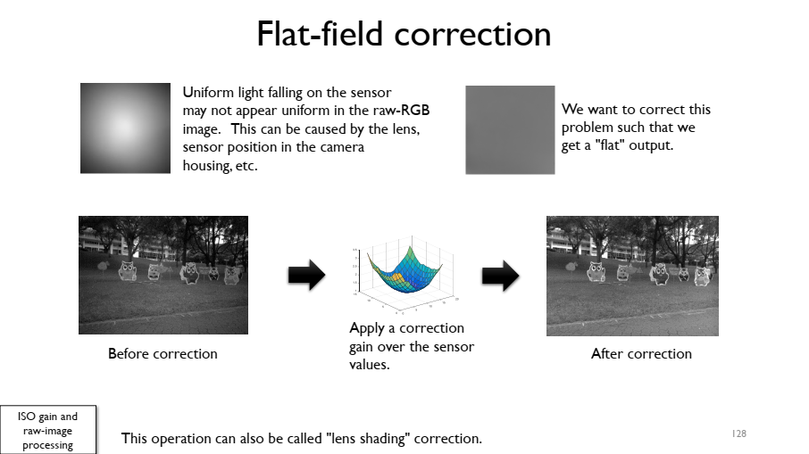

Slide 37
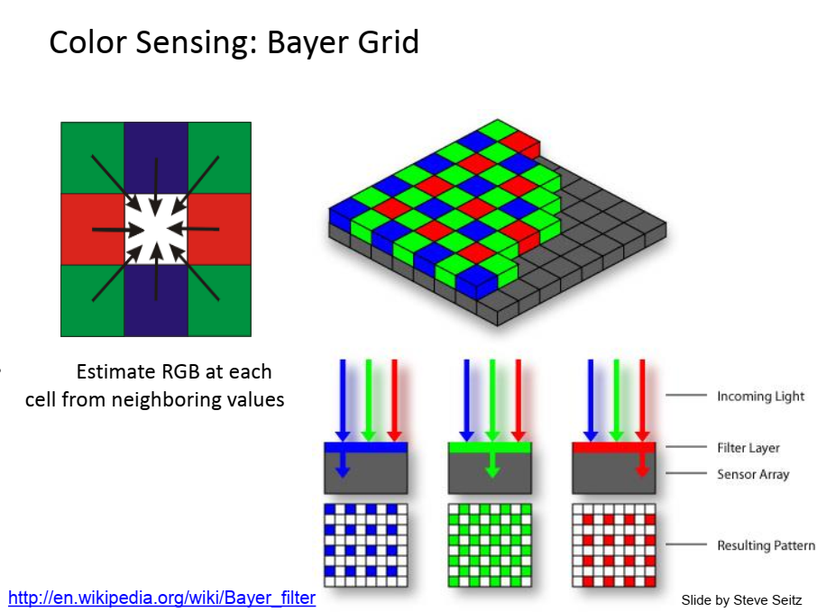

Slide 38
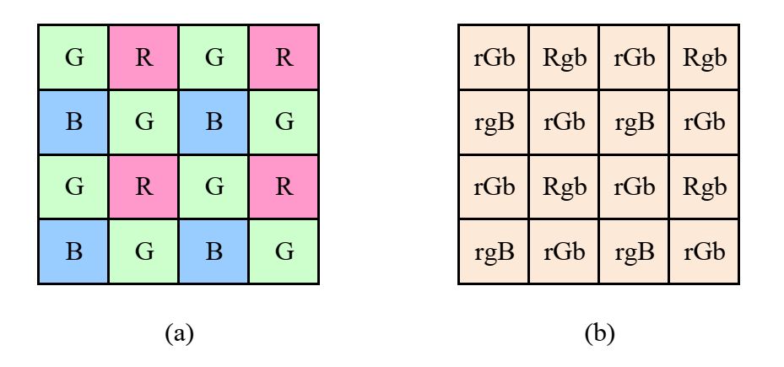
Bayer RGB pattern: (a) color filter array layout; (b) interpolated pixel values, with unknown (guessed) values shown as lower case.

Slide 39
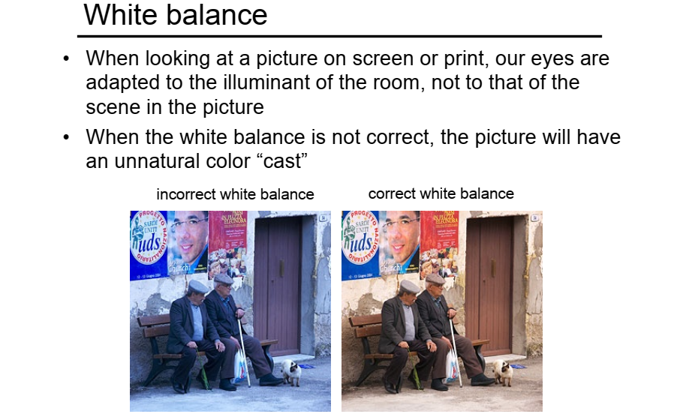
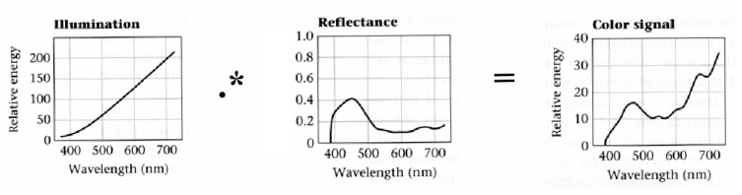

Slide 40
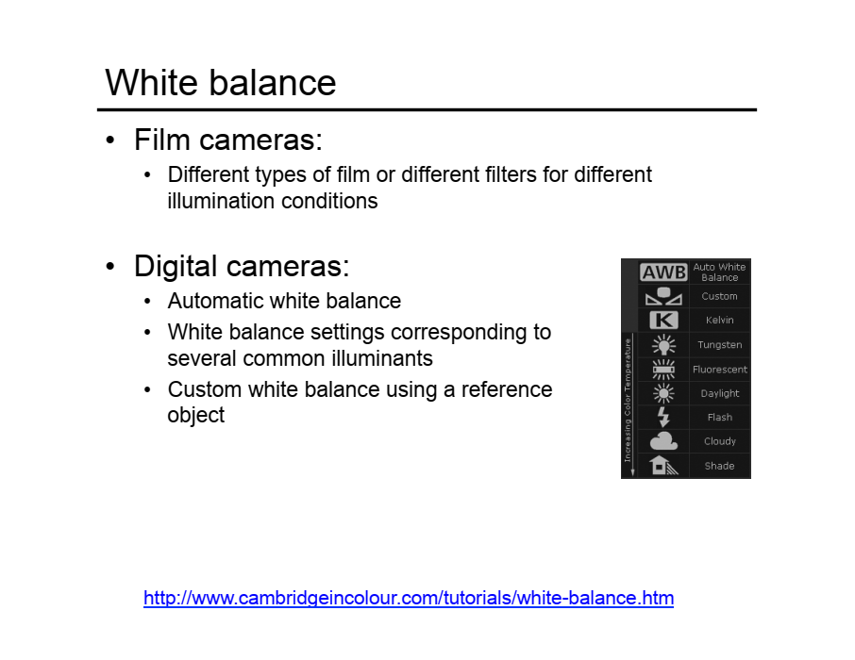

Slide 41
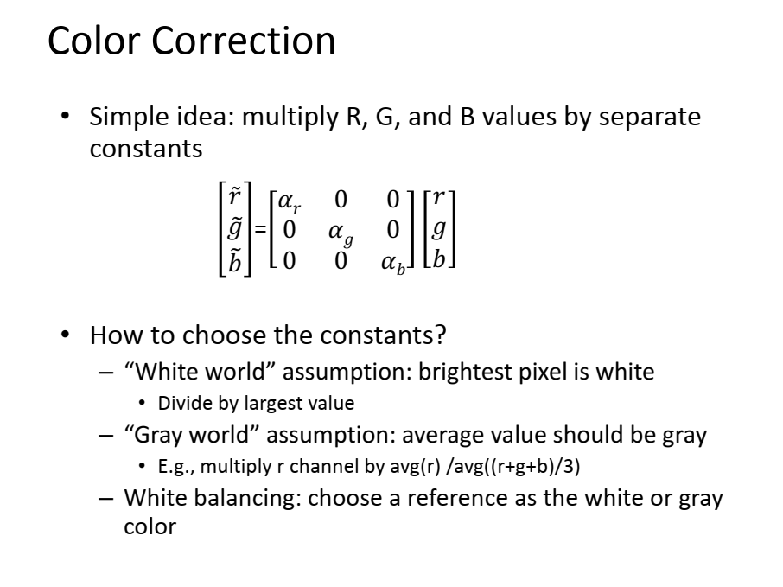

Slide 42
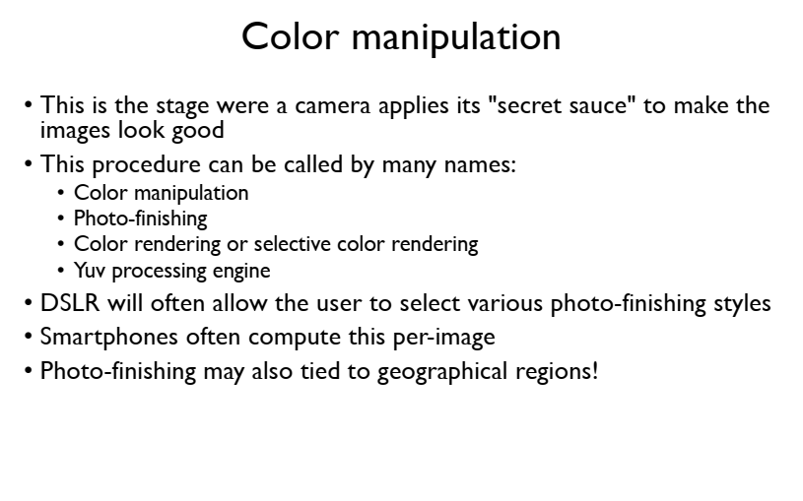

Slide 43
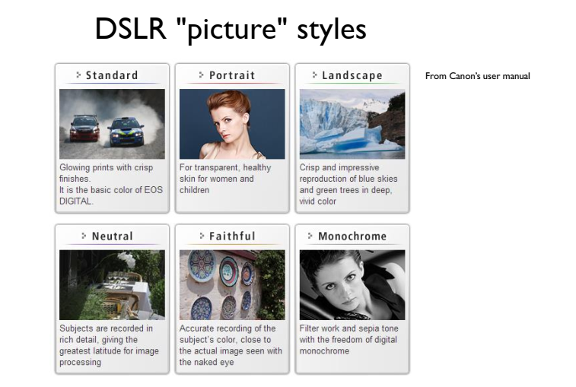

Slide 44
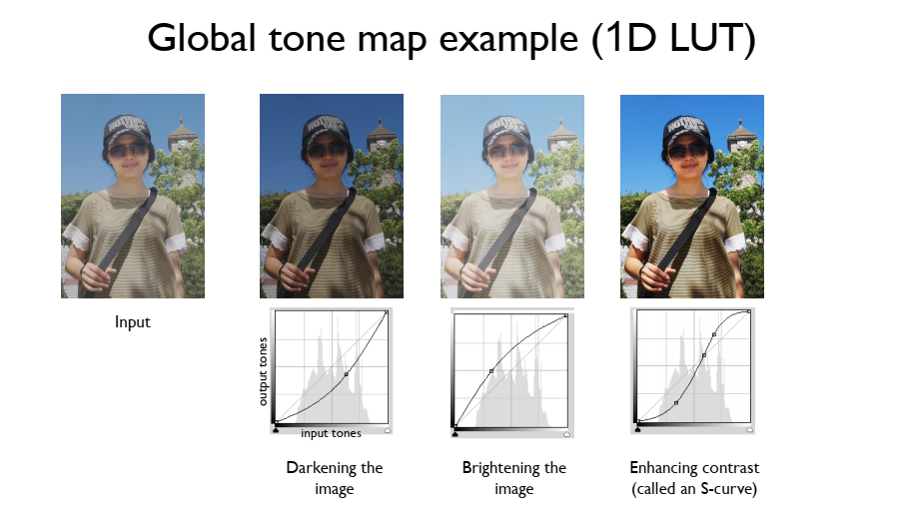

Slide 45
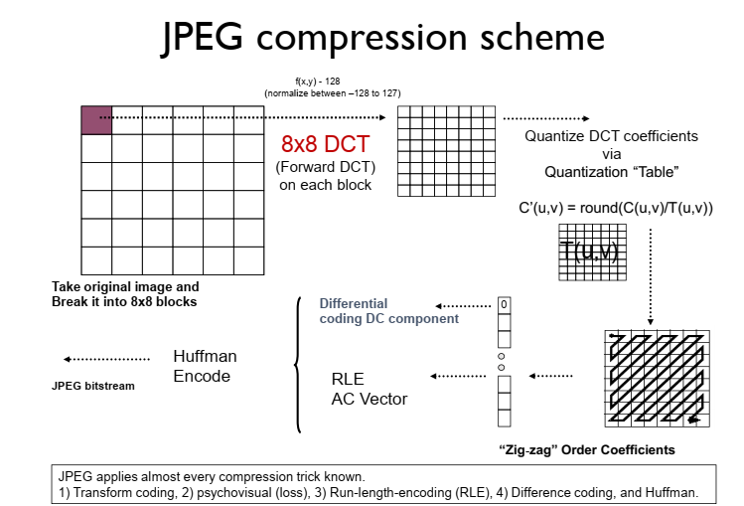

Slide 46
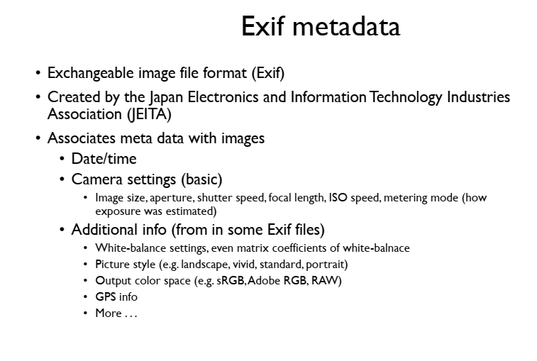

Slide 47
Geometry Camera Models

Slide 48
Geometry Camera Models
Establish quantitative constraints between measurements made in an image and the position and orientation of geometric figures measured in some external coordinate system.
analytical Euclidean geometry
intrinsic parameters
extrinsic parameters

Slide 49
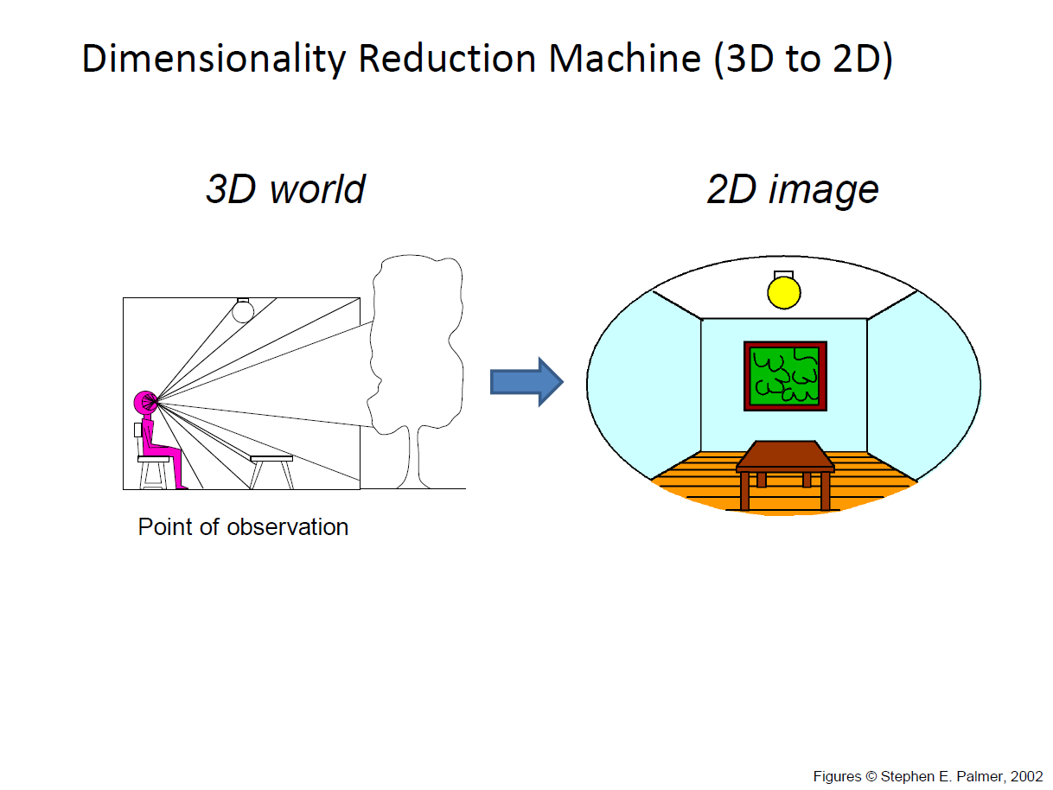

Slide 50
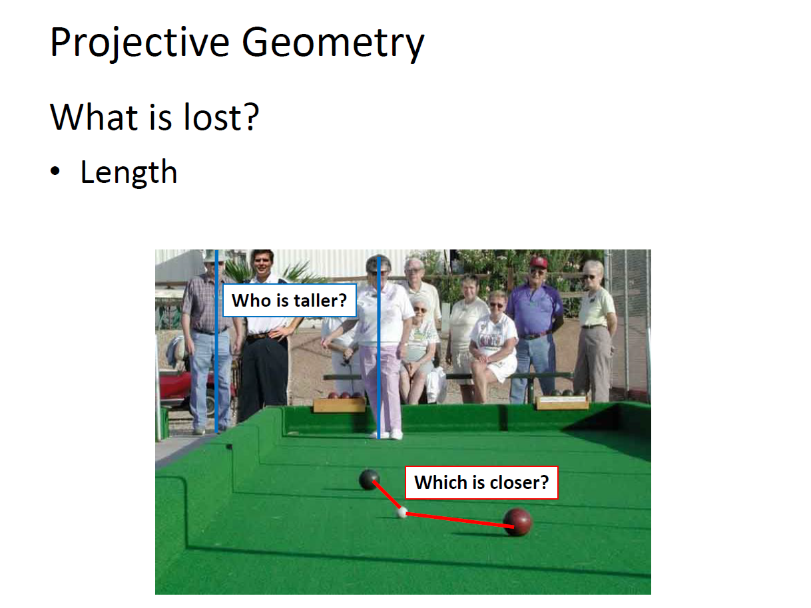

Slide 51
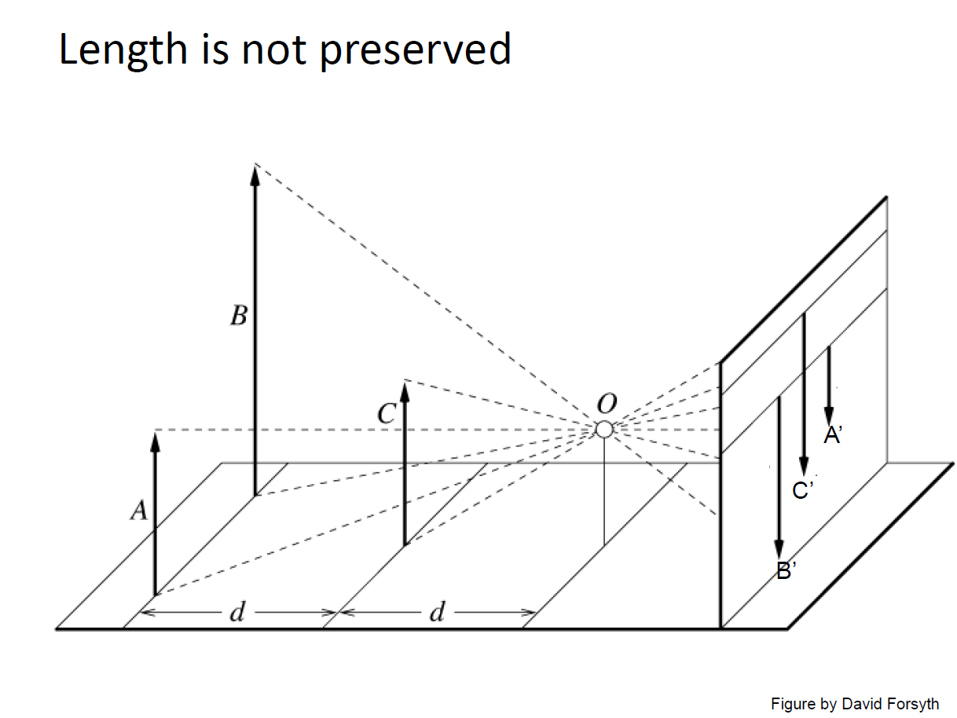

Slide 52
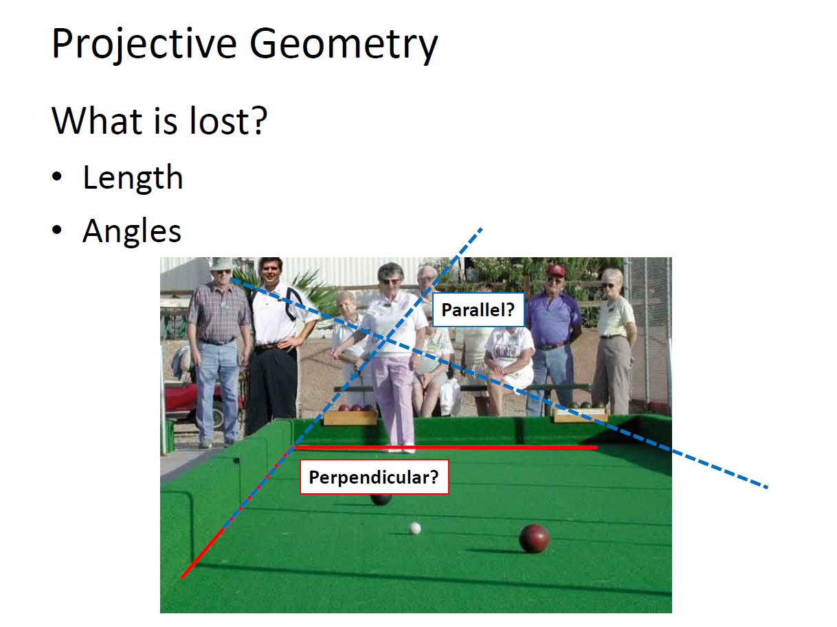

Slide 53
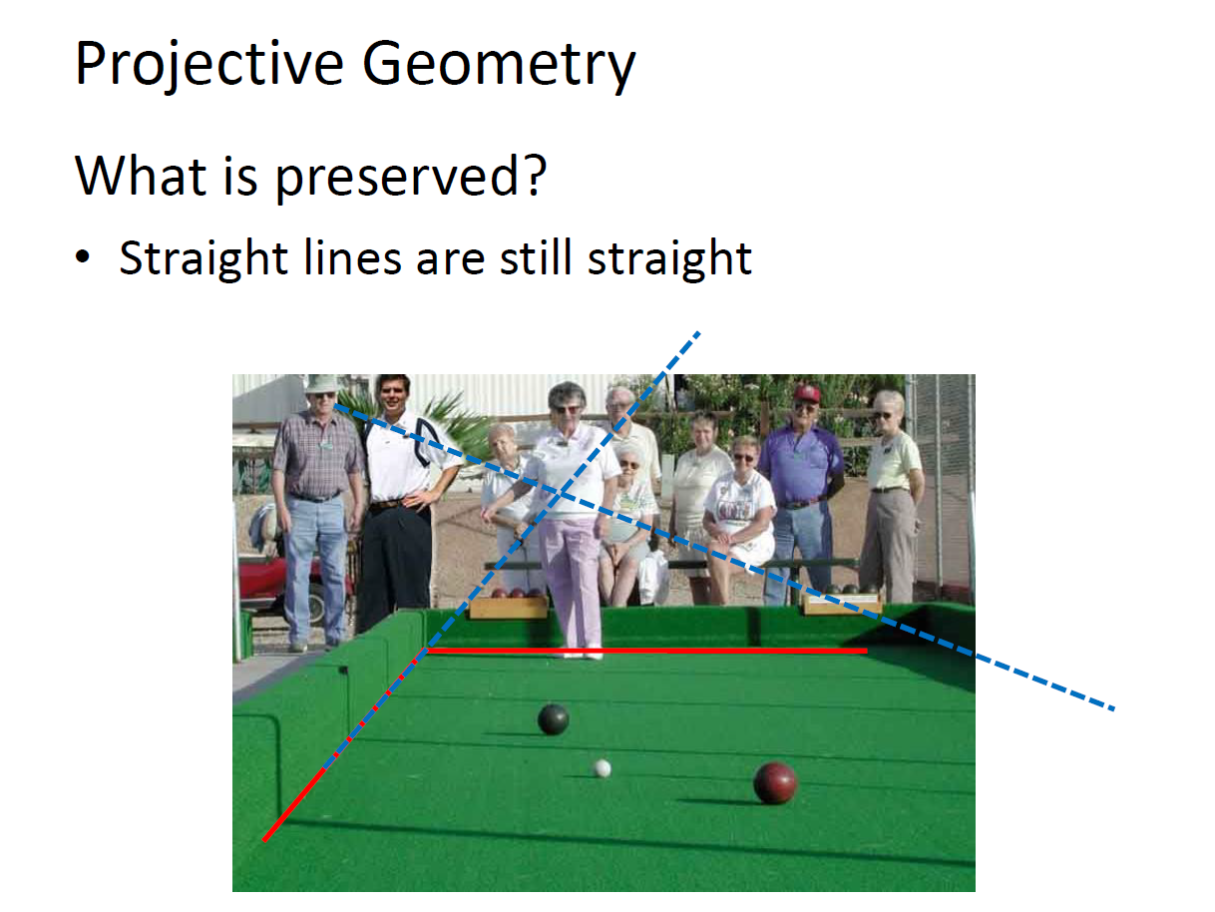

Slide 54
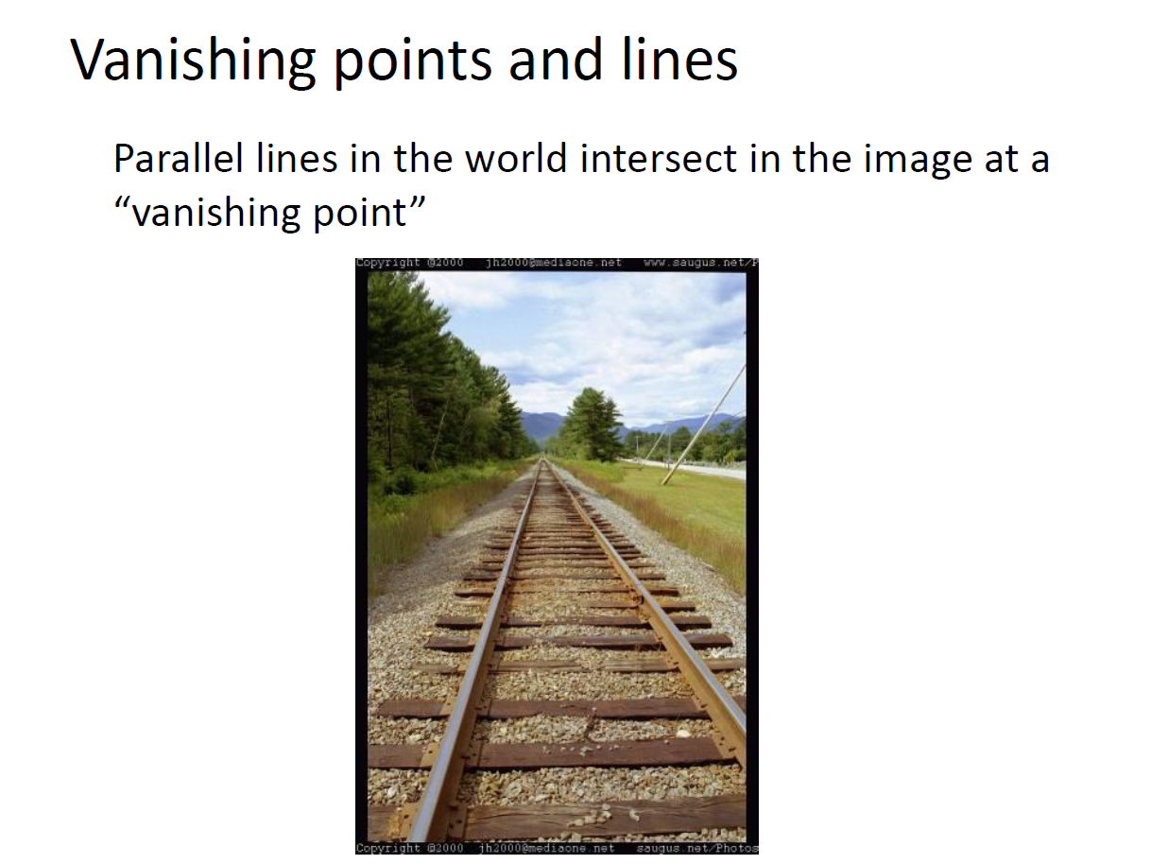

Slide 55
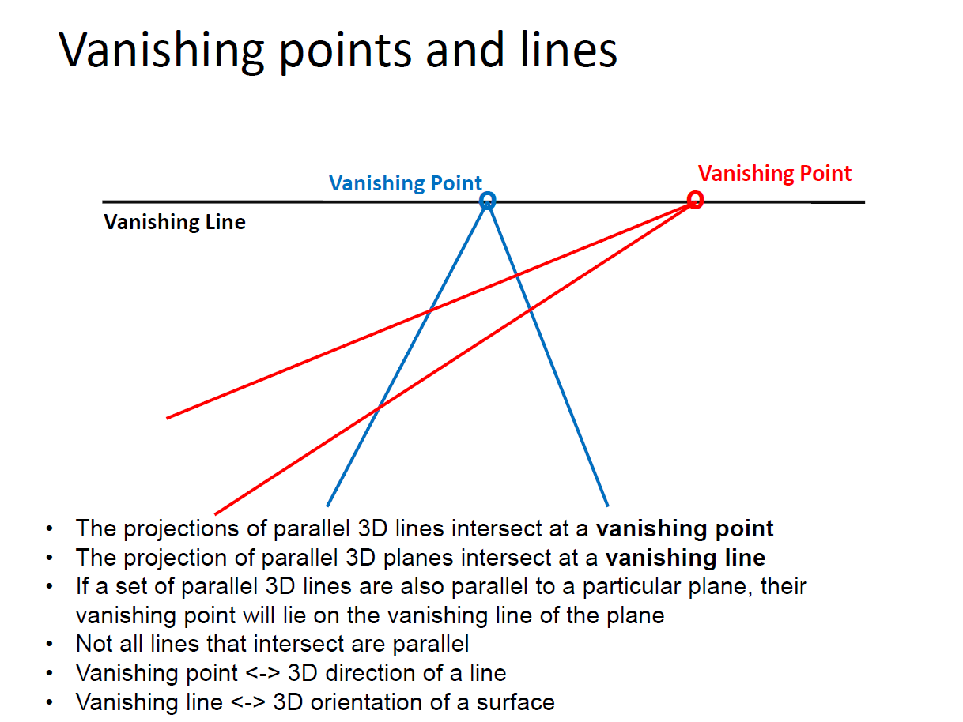

Slide 56
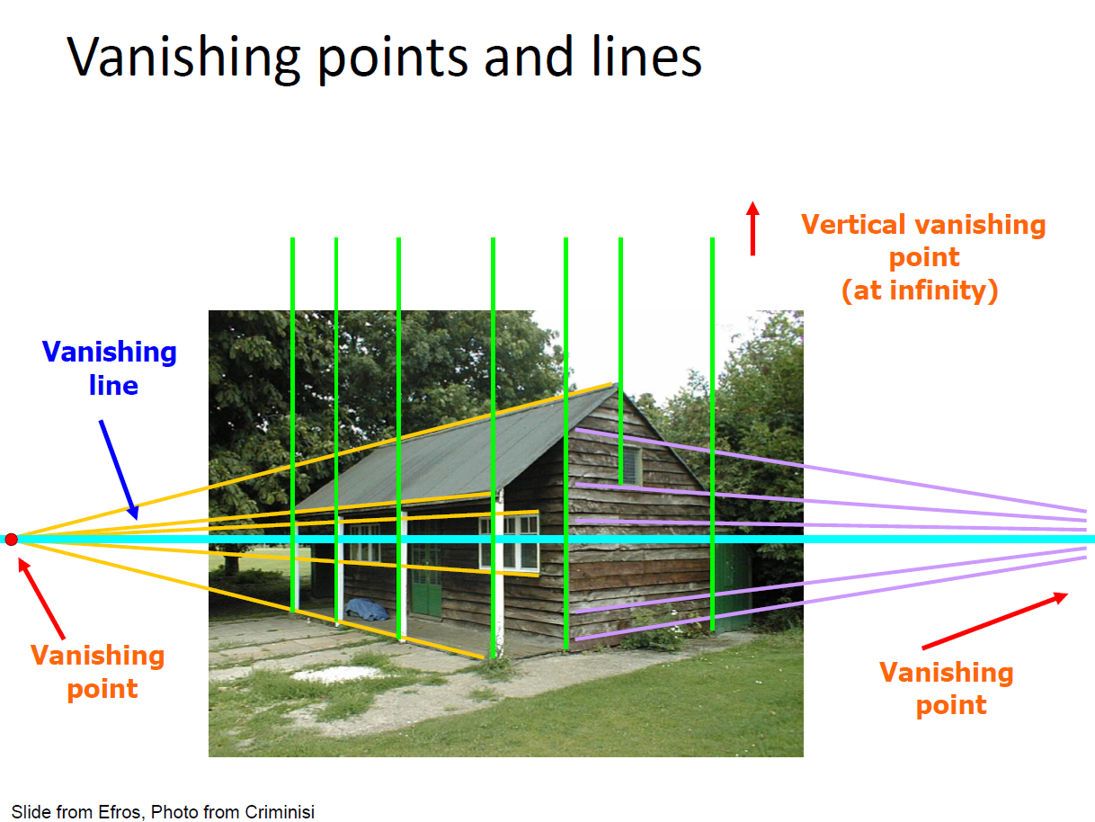

Slide 68
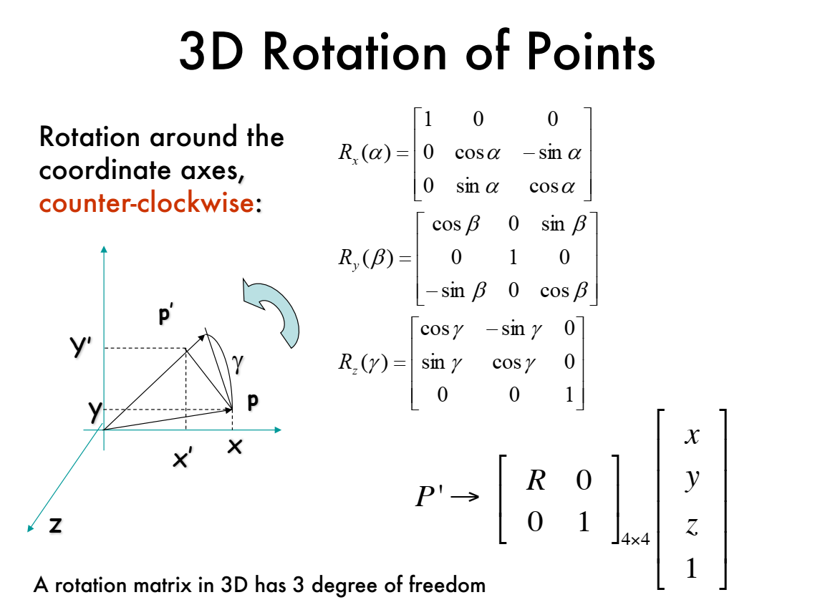

Slide 69
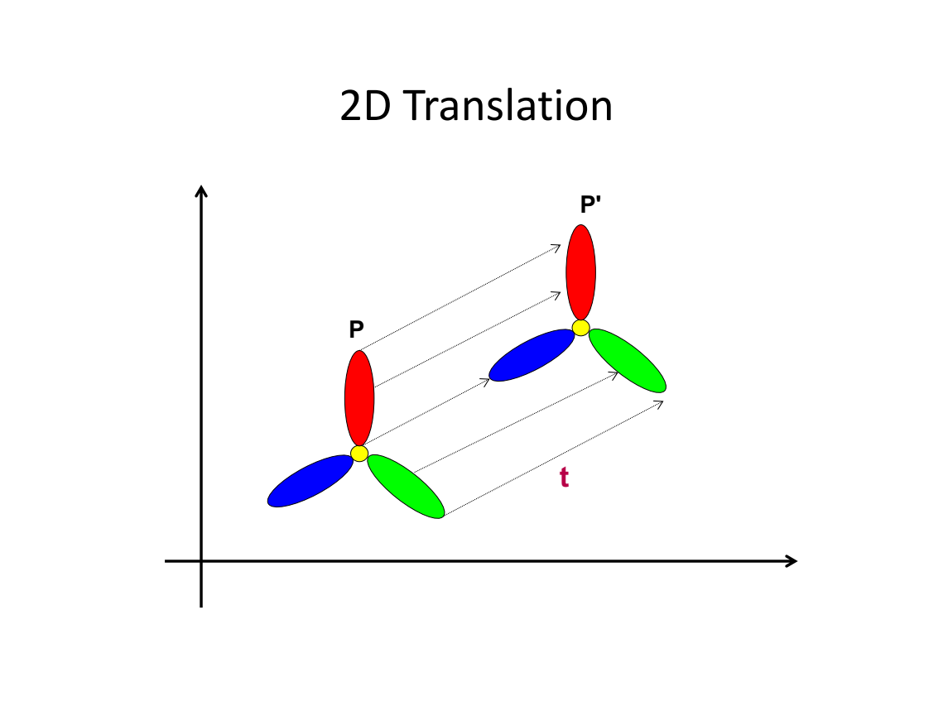

Slide 71
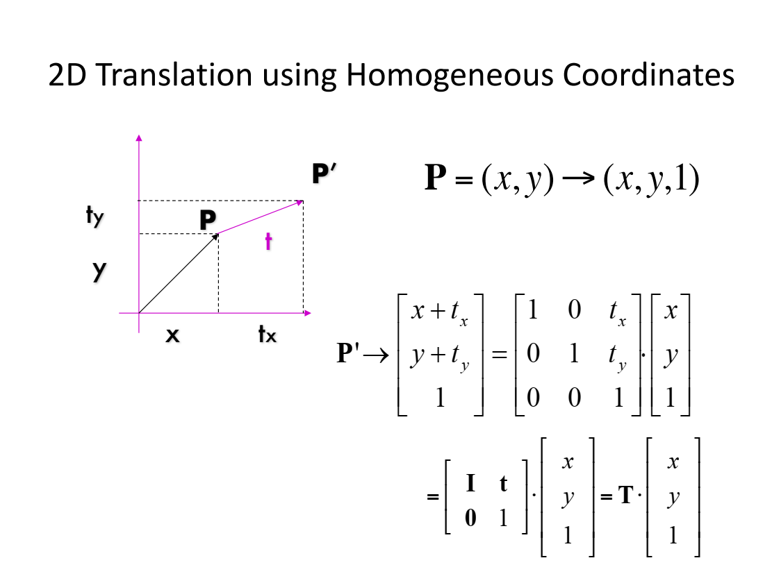

Slide 75


Slide 77


Slide 78


Slide 84
Summary
Mapping between image and world coordinates
Pinhole camera model
Projective geometry
Projection matrix

Slide 85
Camera Calibration

Slide 88


Slide 89


Slide 90


Slide 91


Slide 92


Slide 93


Slide 94


Slide 95


Slide 96


Slide 97


Slide 98


Slide 99


Slide 100


Slide 101


Slide 102


Slide 103


Slide 104


Slide 105


